Slide 1

Analysis of Opioid Deaths in the U.S.
We heart
Dave Gillis
Data Wonders Group
10 April 2023
Javon “that’s our GitHub guy” Seaforth
Amit “everyone’s SME for help with graded challenges” Sharma
Kyle “looks (not brains) of the operation” Eaton

Slide 2
Background/Proposed Analysis
Anecdotal evidence that opioid abuse/opioid deaths are a big problem in the U.S.
News/social media – we constantly hear about all the deaths/issues with opioids
Perhaps we know someone who has passed from opioid abuse
Stressful society we live in today – people are turning to coping mechanisms (e.g., alcohol/drugs, anxiety meds, etc.)
We assume opioid deaths are in the “top 5” category of deaths in the U.S.
Problem/analysis
What are the leading predictors of opioid abuse/opioid deaths in the U.S.?
Goal - want to be able to predict opioid deaths in U.S. to focus resources at prevention = “resources are limited”
Big problem to try and solve/bound – potential datasets initially found are huge
For this first project, we are using large datasets found easily/quickly
Trying to predict opioid abuse/deaths so preventive resources can be allocated to the problem

Slide 3
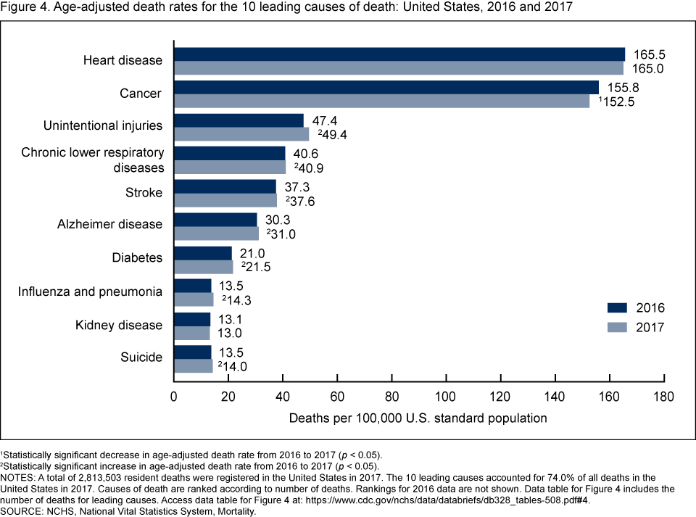
Background/Proposed Analysis (cont.)
Quick look at another analysis shows as recently as 2017, opioid deaths are not one of the leading death categories in the U.S.
Source: CDC.gov
According to another study, 71% of opioid deaths are attributed to ages 25 -54; this is a vital age group for “breadwinning”
Source: National Safety Council
Opioid deaths not in “top 5” (or “top 10” for that matter)... but still important!
Still would like to tackle the opioid problem

Slide 4
Dataset & Methodology
Various data sources (2011 – 2017):
Population - https://www.census.gov
Death by Opioid Type – wonder.cdc.gov
Education - factfinder.census.gov
Income - factfinder.census.gov
Data sources combined into csv. file and found on Kaggle website (www.kaggle.com)
500k+ rows of data
all (50) states represented; 1,890 counties represented
metadata includes county population, education levels, income levels, etc.
Extracted information at national level using “groupby.first” function in Pandas
learned that the data could not be broken down at drug-type level
Completed regressions between opioid casualty and a.) income and b.) education at U.S. level
initial look at correlation/prediction of opioid deaths using metadata columns

Slide 5
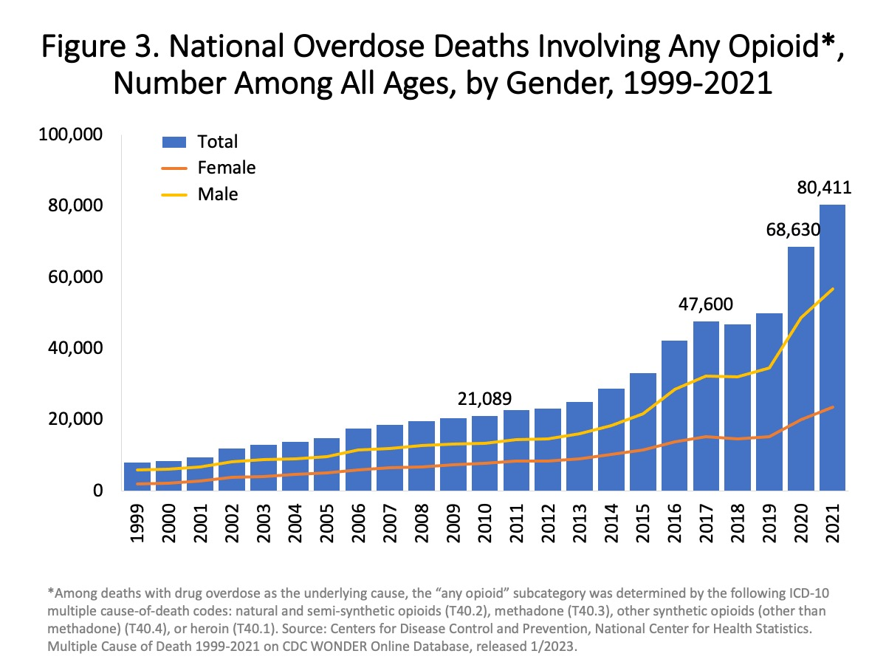
Dataset & Methodology (cont.)
Quick look at another analysis shows 2017 U.S. death count is comparable to the value in our dataset
Source: CDC.gov
Allows us to conclude our dataset can be used confidently for an initial excursion at this opioid problem
47,600 deaths (2017) similar to our dataset value in 2017 (49,608)
Secondary analysis/data source helps validate our dataset may be reliable

Slide 6
Possible Predictor of Opioid Deaths - Income
Average annual income for U.S. states regressed against # of opioid deaths in U.S. to see if death prediction plausible
Correlation (rho): 0.93; strong correlation = strong positive relationship
Possible issues w/ regression include:
income increase could be attributed to inflation/price increases
only (6) Degrees of Freedom/(7) datapoints; limited data
Correlation does not equal causation – need to investigate relationship further

Slide 7
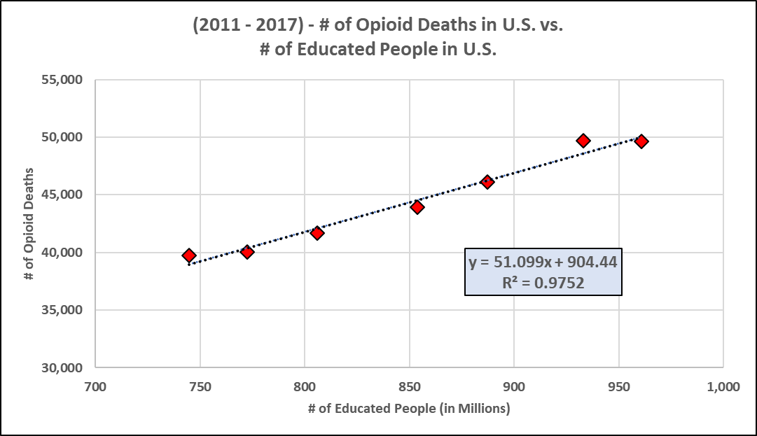
Possible Predictor of Opioid Deaths - Educated
# of educated individuals in U.S. states regressed against # of opioid deaths in U.S. to see if death prediction plausible
Assumption – “educated” equals Bachelor/4-year degrees and Master’s/post-graduate degrees
Correlation (rho): 0.99; strong correlation = strong positive relationship
Possible issues w/ regression include:
uneducated has similar fit = not an important factor in opioid deaths?
only (6) Degrees of Freedom/(7) datapoints; limited data
Correlation does not equal causation – need to investigate relationship further

Slide 8
Possible Predictor of Opioid Deaths - Uneducated
# of uneducated individuals in U.S. states regressed against # of opioid deaths in U.S. to see if death prediction plausible
Assumption – “uneducated” equals some high school, high school grad and some college
Correlation (rho): 0.99; strong correlation = strong positive relationship
Possible issues w/ regression include:
educated has similar fit = not an important factor in opioid deaths?
only (6) Degrees of Freedom/(7) datapoints; limited data
Correlation does not equal causation – need to investigate relationship further

Slide 9

Initial Findings/Considerations
Data Quality
Initial regressions of data (i.e., education, income) not enough to feel confident in understanding opioid abuse/deaths
Potential key subfactors not available in this dataset: age, gender, employment status, alcohol use, criminal history, history of mental health issues, etc.
Opioid Deaths Prevalent in Key Generation
Impacting younger folks – Taking away able-bodied capable people
Hence understanding and solving opioid abuse/deaths vital to our nation (socioeconomic impact, GDP impact, etc.)
COVID-19 Impact
Game changing impact – huge increase in 2020+ opioid deaths (see graph) – need to do further analysis on more recent data

Slide 10
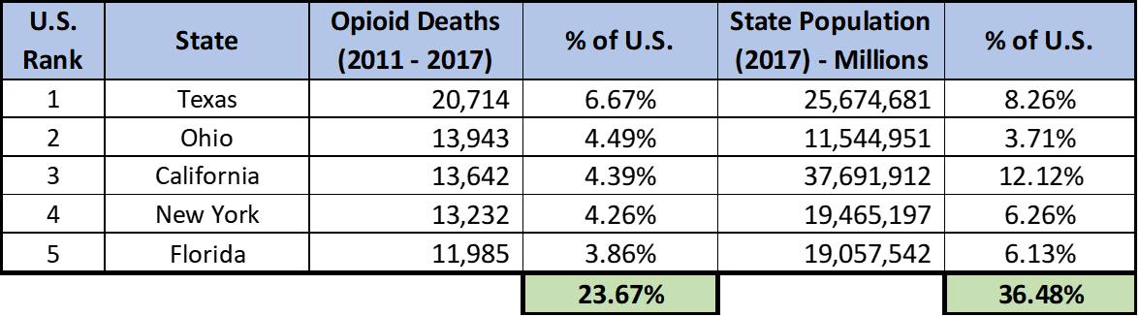
Takeaways/Conclusion
Opioid abuse/opioid death is an issue
Deaths continue to increase & key demographic (young folks) still impacted
Quality of this data not great
Several factors not available (Age, gender and employment status of people)
Data is older – Need updated information for more accurate conclusion
Have not found
Analysis potentially needed at state level
?
Path forward on this analysis still in question
Do we investigate at the state level? Do we sample the data to make inferences about the population?
Do we pivot towards another analysis?

Slide 11
Questions?

Slide 12
Backup

Slide 13
Method
Raw data for 2011 to 2017 timeframe obtained from wonder.cdc.gov as a csv file (over 0.5 M rows)
Extracted information at national level using “groupby.first” function in pandas
Learned that the data could not be broken down at drug type level
completed a regression between opioid casualty and several factors (income, education, employment) at US level
Completed a State ranking by deaths in each state
2022 has been the deadliest year for opioid overdoses in the U.S. (yahoo.com)
Drug Overdose Death Statistics [2023]: Opioids, Fentanyl & More (drugabusestatistics.org)

Slide 14
Takeaways
Drug Use Epidemic?
Impacting younger folks – Taking away able-bodied capable people
Increased econo-social liability of families left behind
Rate of increase in casualty is significant (doubled from 2019 to 2023)
Data Quality
Several factors not available (Age, gender and employment status of people)
Data is older – Need updated information for more accurate conclusion
COVID 19
Game changing impact – Over 81,000 (~ 38% increase yoy) drug overdose deaths in 12 months period. Data need to be added
Government Policies
Open boarders have increased illicit drug activities – need to look at impact

